Slide 1
Lead Scoring Case Study
By:
Utkarsh Vashisth

Slide 2
Table of Contents:
Background of X Education Company
Problem Statement & Objective of the Study
Suggested Ideas for Lead Conversion
Analysis Approach
Data Cleaning
EDA
Data Preparation
Model Building (RFE & Manual fine tuning)
Model Evaluation
Recommendations

Slide 3
Background of X Education Company:
An education company named X Education sells online courses to industry professionals.
On any given day, many professionals who are interested in the courses land on their website and browse for courses.
The company markets its courses on several websites and search engines like Google.
Once these people land on the website, they might browse the courses or fill up a form for the course or watch some videos.
When these people fill up a form providing their email address or phone number, they are classified to be a lead.
Once these leads are acquired, employees from the sales team start making calls, writing emails, etc.
Through this process, some of the leads get converted while most do not.
The typical lead conversion rate at X education is around 30%

Slide 4
Problem Statement & Objective of the Study :
Problem Statement:
X Education gets a lot of leads, its lead conversion rate is very poor at around 30%
X Education wants to make lead conversion process more efficient by identifying the most potential leads, also known as Hot Leads
Their sales team want to know these potential set of leads, which they will be focusing more on communicating rather than making calls to everyone.
Objective of the Study:
To help X Education select the most promising leads, i.e., the leads that are most likely to convert into paying customers.
The company requires us to build a model wherein we need to assign a lead score to each of the leads such that the customers with a higher lead score have a higher conversion chance and the customers with a lower lead score have a lower conversion chance
The CEO has given a ballpark of the target lead conversion rate to be around 80%

Slide 5
Suggested Ideas for Lead Conversion:
Leads are grouped based on their propensity or likelihood to convert.
This results in a focused group of hot leads.
We could have a smaller pool of leads to communicate with, which would allow us to have a greater impact.
We would have a greater conversion rate and be able to hit the 80% objective since we concentrated on hot leads that were more likely to convert. Since we have a target of 80% conversion rate, we would want to obtain a high sensitivity in obtaining hot leads

Slide 6
Analysis Approach:
Data Cleaning: Loading Data Set, understanding & cleaning data
EDA: Check imbalance, Univariate & Bivariate analysis Data Preparation Dummy variables, test-train split, feature scaling
Model Building: RFE for top 15 feature, Manual Feature Reduction & finalizing model
Model Evaluation: Confusion matrix, Cut-off Selection, assigning Lead Score
Predictions on Test Data: Compare train vs test metrics, Assign Lead Score and get top features
Recommendation: Suggest top 3 features to focus for higher conversion & areas for improvement

Slide 7
Data Cleaning:
"Select" level represents null values for some categorical variables, as customers did not choose any option from the list.
Columns with over 40% null values were dropped.
Missing values in categorical columns were handled based on value counts and certain considerations.
Drop columns that don't add any insight or value to the study objective (tags, country)
Imputation was used for some categorical variables.
Additional categories were created for some variables.
Columns with no use for modeling (Prospect ID, Lead Number) or only one category of response were dropped.
Numerical data was imputed with mode after checking distribution

Slide 8
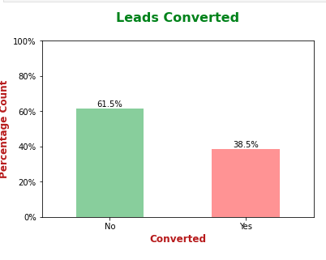
Exploratory Data Analysis:
Data is imbalanced while analyzing target variable.
Conversion rate is of 38.5%, meaning only 38.5% of the people have converted to leads.(Minority)
While 61.5% of the people didn't convert to leads. (Majority)

Slide 9
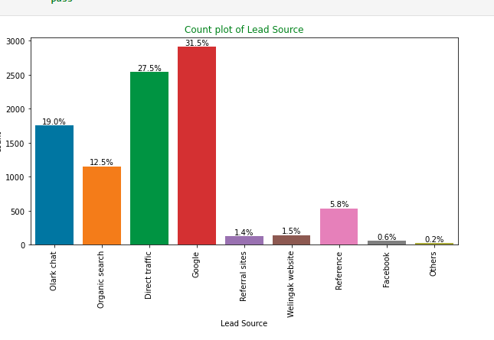
Exploratory Data Analysis:
Univariate Analysis – Categorical Variables
Lead Source: 58% Lead source is from Google & Direct Traffic combine

Slide 10
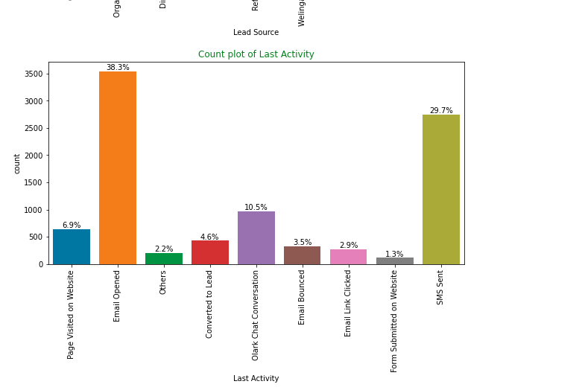
EDA:
Last Activity: 68% of customer contribution in SMS Sent & Email Opened activities.

Slide 11
EDA – Bivariate Analysis for Categorical Variables
Lead Origin:
Around 52% of all leads originated from "Landing Page Submission" with a lead conversion rate (LCR) of 36%.
The "API" identified approximately 39% of customers with a lead conversion rate (LCR) of 31%.

Slide 12
EDA – Bivariate Analysis for Categorical Variables
Current occupation:
Around 90% of the customers are Unemployed, with lead conversion rate (LCR) of 34%.
While Working Professional contribute only 7.6% of total customers with almost 92% Lead conversion rate (LCR

Slide 13
EDA – Bivariate Analysis for Categorical Variables
92% of the people has opted that they don't want to be emailed about the course & 40% of them are converted to leads

Slide 14
EDA – Bivariate Analysis for Categorical Variables
Lead Source:
Google has LCR of 40% out of 31% customers,
Direct Traffic contributes 32% LCR with 27% customers, which is lower than Google,
Organic Search also gives 37.8% `of LCR, but the contribution is by only 12.5% of customers,
Reference has LCR of 91%, but there are only around 6% of customers through this Lead Source

Slide 15
EDA – Bivariate Analysis for Categorical Variables
Last Activity:
'SMS Sent' has high lead conversion rate of 63% with 30% contribution from last activities,
'Email Opened' conversion rate

Slide 16
Data Preparation before Model building:
Binary level categorical columns were already mapped to 1 / 0 in previous steps
Created dummy features (one-hot encoded) for categorical variables – Lead Origin, Lead Source, Last Activity, Specialization, Current occupation
Splitting Train & Test Sets ○ 70:30 % ratio was chosen for the split
Feature scaling ○ Standardization method was used to scale the features
Checking the correlations ○ Predictor variables which were highly correlated with each other were dropped (Lead Origin Lead Import and Lead Origin Lead Add Form)

Slide 17
Model Building:
Feature Selection
The data set has lots of dimension and large number of features.
This will reduce model performance and might take high computation time.
Hence it is important to perform Recursive Feature Elimination (RFE) and to select only the important columns.
Then we can manually fine tune the model.
RFE outcome ○ Pre RFE – 48 columns & Post RFE – 15 column

Slide 18
Model Building:
Manual Feature Reduction process was used to build models by dropping variables with p – value greater than 0.05.
Model 4 looks stable after four iteration with: ○significant p-values within the threshold (p-values < 0.05) and ○No sign of multicollinearity with VIFs less than 5
Hence, logm4 will be our final model, and we will use it for Model Evaluation which further will be used to make predictions

Slide 19
Model Evaluation:
Train Data Set:
Confusion Matrix & Evaluation Metrics with 0.345 as cutoff Confusion Matrix & Evaluation Metrics with 0.41 as cutoff It was decided to go ahead with 0.345 as cutoff after checking evaluation metrics coming from both plot.
Confusion Matrix & Evaluation Metrics with 0.345 as cutoff
Confusion Matrix & Evaluation Metrics with 0.41 as cut-off

Slide 20
Model Evaluation:
ROC Curve – Train Data Set
Area under ROC curve is 0.88 out of 1 which indicates a good predictive model.
The curve is as close to the top left corner of the plot, which represents a model that has a high true positive rate and a low false positive rate at all threshold values

Slide 21
Model Evaluation:
Confusion Matrix & Metrics
Train Data Set
Test Data Set
Using a cut-off value of 0.345, the model achieved a sensitivity of 80.05% in the train set and 79.82% in the test set.
Sensitivity in this case indicates how many leads the model identify correctly out of all potential leads which are converting
The CEO of X Education had set a target sensitivity of around 80%.
The model also achieved an accuracy of 80.46%, which is in line with the study's objectives

Slide 22
Recommendation based on Final Model:
As per the problem statement, increasing lead conversion is crucial for the growth and success of X Education. To achieve this, we have developed a regression model that can help us identify the most significant factors that impact lead conversion.
We have determined the following features that have the highest positive coefficients, and these features should be given priority in our marketing and sales efforts to increase lead conversion.
Lead Source_Welingak Website: 5.39
Lead Source_Reference: 2.93
Current_occupation_Working Professional: 2.67
Last Activity_SMS Sent: 2.05
Last Activity_Others: 1.25
Total Time Spent on Website: 1.05
Last Activity_Email Opened: 0.94
Lead Source_Olark Chat: 0.91
We have also identified features with negativecoefficients that may indicate potential areas for improvement. These include:
Specialization in Hospitality Management: -1.09
Specialization in Others: -1.20
Lead Origin of Landing Page Submission: -1.2

Slide 23
Recommendation based on Final Model:
Last Activity_SMS Sent: 2.05
Last Activity_Others: 1.25
Total Time Spent on Website: 1.05
Last Activity_Email Opened: 0.94
Lead Source_Olark Chat: 0.91
We have also identified features with negativecoefficients that may indicate potential areas for improvement. These include:
Specialization in Hospitality Management: -1.09
Specialization in Others: -1.20
Lead Origin of Landing Page Submission: -1.2

Slide 24
Recommendation based on Final Model:
To increase our Lead Conversion Rates :
1. Targeted Marketing Strategies:
Focus on features with positive coefficients for effective marketing strategies.
2. Attract High-Quality Leads:
Develop strategies to attract high-quality leads from top-performing sources.
3. Tailored Messaging:
Engage working professionals with personalized messaging.
4. Optimize Communication:
Enhance communication channels based on their impact on lead engagement

Slide 25
Recommendation based on Final Model:
5. Website Advertising:
Allocate more budget for advertising on the Welingak website.
6. Referral Incentives:
Offer incentives/discounts for successful referrals to encourage more references.
7. Target Working Professionals:
Implement aggressive targeting of working professionals due to their high conversion rates and better financial capacity. To identify areas of improvement
Analyze negative coefficients in specialization offerings.
Review landing page submission process for areas of improvement
To identify areas of improvement
Analyze negative coefficients in specialization offerings.
Review landing page submission process for areas of improvement

Slide 26
Thank You

